Slide 1
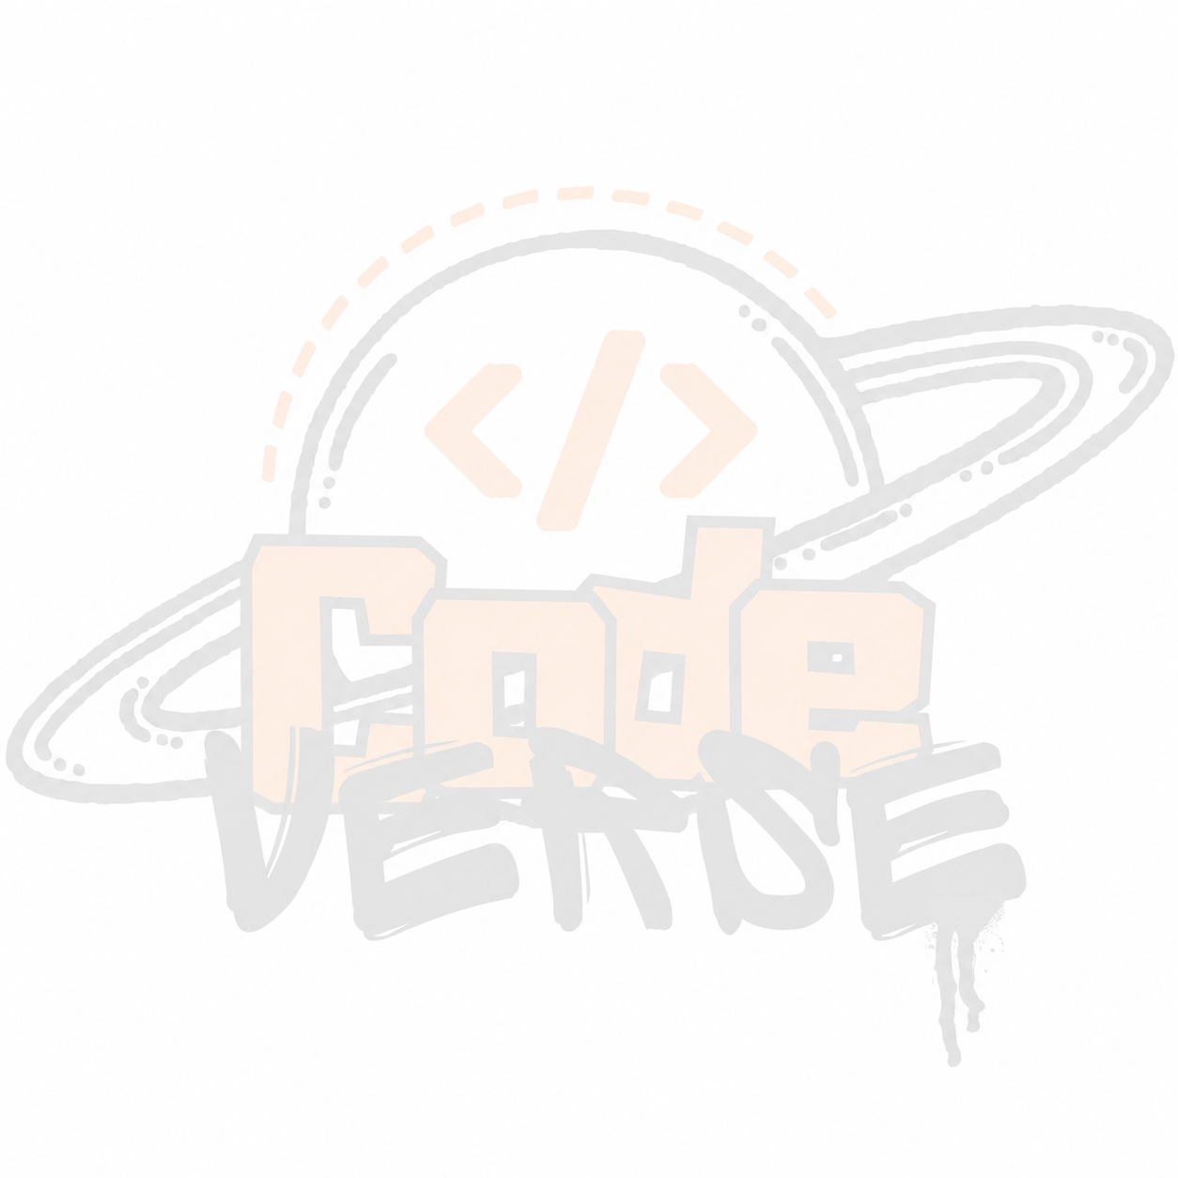


BUILD
WITH
भारत 4.0
NATIONAL LEVEL HACKATHON
TEAM NAME: Codetech
PROBLEM STATEMENT: Multimodal AI Content Detection & Explainable Digital Authenticity
TEAM MEMBERS: VIVEK , ARUSHI , ADITYA , ANSHUL and ASHKAND
COLLEGE: KCC Institute of Technology and Management
BUILD WITH भारत4.0

Slide 2
PROBLEM STATEMENT
The internet is full of realistic content created by AI (images, videos, voices, documents) in seconds.
Most users lack the tools or technical knowledge to verify authenticity themselves.
Key Gap: Existing tools provide raw/opaque percentages (e.g., "92% AI") without explaining the cause.
Fragmented Tools: Users are forced to check images, audio, and provenance separately across different platforms.
BUILD WITH भारत4.0

Slide 3
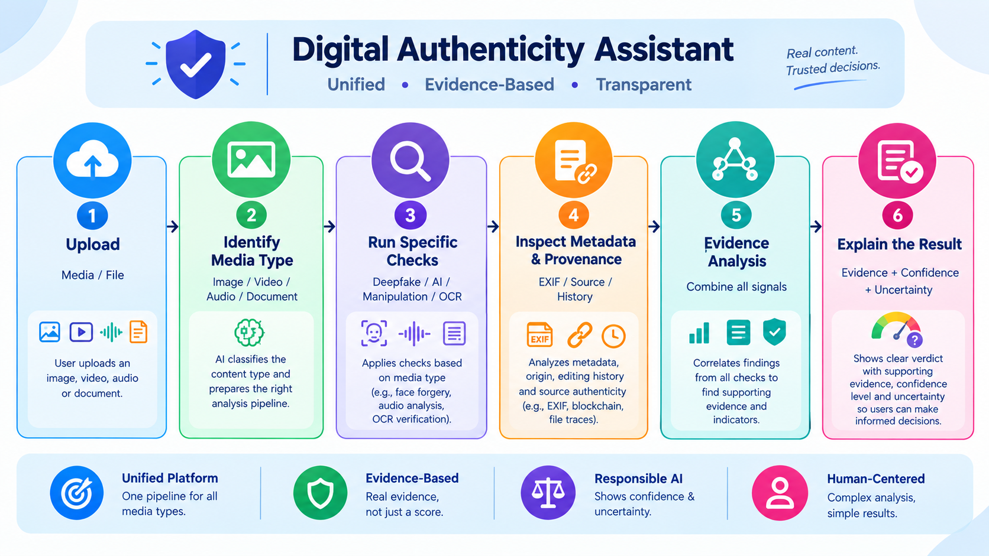
SOLUTION
A unified digital authenticity assistant providing a single pipeline for multimodal content.
Workflow: Upload -> Identify Media Type -> Run Specific Checks -> Inspect Metadata/Provenance -> Explain Result.
Focuses on evidence-based decision support rather than an opaque, single confidence score.
Communicates confidence alongside uncertainty responsibly.
BUILD WITH भारत4.0

Slide 4
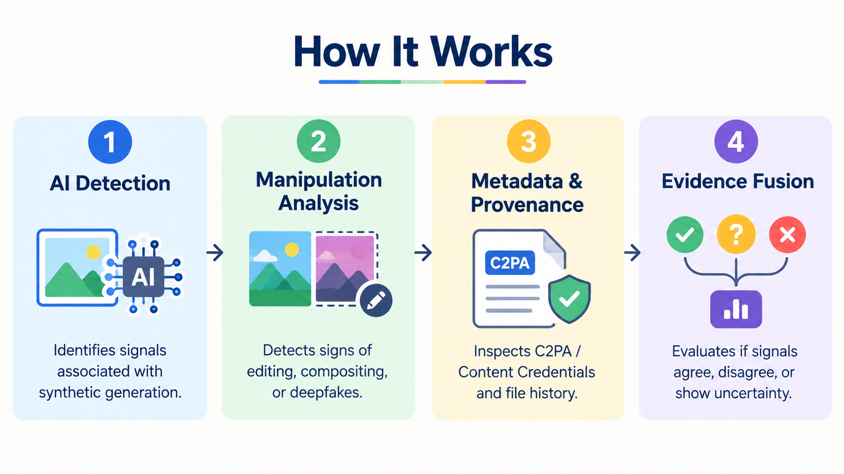
FLOW OF SOLUTION
Pipeline: Upload -> Identify -> Analyze -> Verify -> Explain.
AI Detection: Identifies signals associated with synthetic generation.
Manipulation Analysis: Detects signs of editing, compositing, or Deepfakes.
Metadata & Provenance: Inspects C2PA / Content Credentials and file history.
Evidence Fusion: Evaluates if signals agree, disagree, or show uncertainty.
BUILD WITH भारत4.0

Slide 5
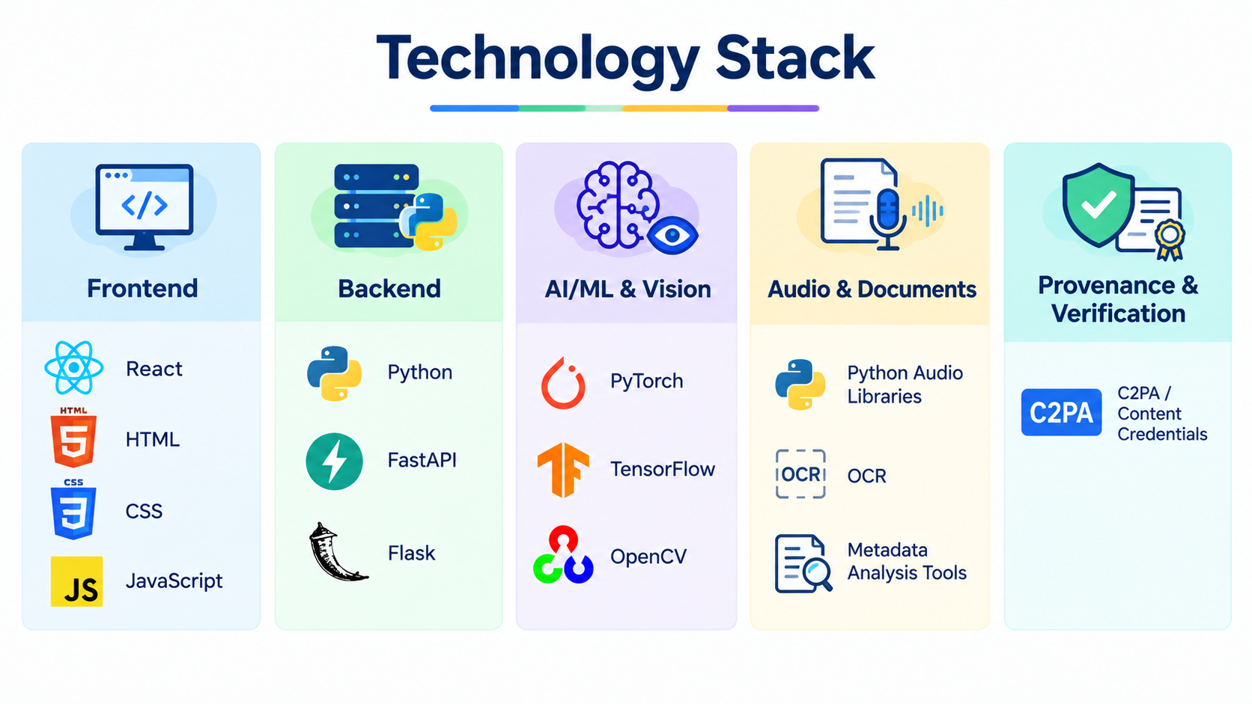
TECH STACK
Frontend: React, HTML, CSS, JavaScript
Backend: Python, FastAPI, Flask
AI/ML & Vision: PyTorch, TensorFlow, OpenCV
Audio & Documents: Python Audio Libraries, OCR, Metadata Analysis Tools
Provenance & Verification: C2PA / Content Credentials
BUILD WITH भारत4.0

Slide 6
UNIQUE SELLING PROPOSITION (USP)
Don't just say "FAKE" — Explain the evidence
Our Approach
Outputs "High authenticity risk" + explicit signals
(e.g., AI signal detected + manipulation indicator + no verifiable provenance found)
  Typical Approach
  Outputs a mysterious number like "AI Generated - 92%"
Contrast: Gives clear reasoning and human-understandable report explanations
BUILD WITH भारत4.0

Slide 7
FEASIBILITY & COMPETITORS
Existing Landscape:
Hive (AI-generated content & deepfake detection)
Reality Defender (Multimodal synthetic-media detection)
C2PA / Content Credentials (Verifiable origin/provenance)
Our Edge: Connects separate detection capabilities into one clear, integrated, evidence-based user experience.
Implementation Feasibility (MVP Scope):
Hackathon MVP: Image + Video analysis pipeline.
Next Scope Expansion: Audio detection module.
BUILD WITH भारत4.0

Slide 8
RESEARCH & REFERENCE
Reference Specifications & Docs:
Hive AI Documentation: AI generation & image/video detection
Reality Defender: Multimodal deepfake detection
C2PA Specification: Content Credentials & verifiable provenance
And Others
BUILD WITH भारत4.0

